Slide 1


Weight & Biases
with
run:ai

Slide 2
Weights & Biases background

Slide 3
How does W&B work?

Slide 4
How does W&B work?
Python scripts (with wandb code) are run within an environment that has the wandb package installed.
(your environment)
(python script)
wandb

Slide 5


How does W&B work?
Python scripts (with wandb code) are run within an environment that has the wandb package installed.
Experiment information is sent to a wandb.ai web account.*
wandb.ai
(your environment)
(python script)
wandb

Slide 6
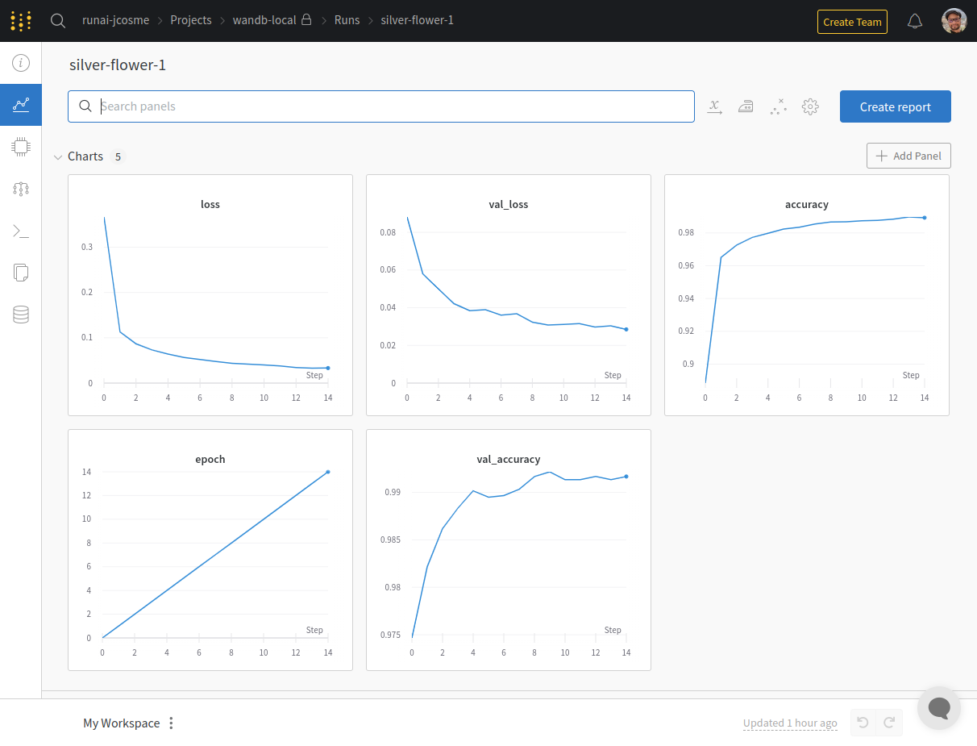
How does W&B work?
Python scripts (with wandb code) are run within an environment that has the wandb package installed.
Experiment information is sent to a wandb.ai web account.*
You can view all experiment information on the wandb.ai web account*
wandb.ai
(your environment)
(python script)
wandb

Slide 7
How does W&B work?
Python scripts (with wandb code) are run within an environment that has the wandb package installed.
Experiment information is sent to a wandb.ai web account.*
You can view all experiment information on the wandb.ai web account*
wandb.ai
(your environment)
(python script)
wandb
*Note that W&B does offer “on-prem” solutions, that do not require a wandb.ai web account.

Slide 8
What is needed for W&B to run?

Slide 9
What is needed for W&B to run?
1) An account with W&B

Slide 10
What is needed for W&B to run?
1) An account with W&B
2) The “wandb” package installed

Slide 11
What is needed for W&B to run?
1) An account with W&B
2) The “wandb” package installed
3) A .netrc file (create by running “wandb login” command)

Slide 12
What is needed for W&B to run?
1) An account with W&B
2) The “wandb” package installed
3) A .netrc file (create by running “wandb login” command)
4) Run wandb code within your python script

Slide 13
Step 1: Create account with W&B

Slide 14
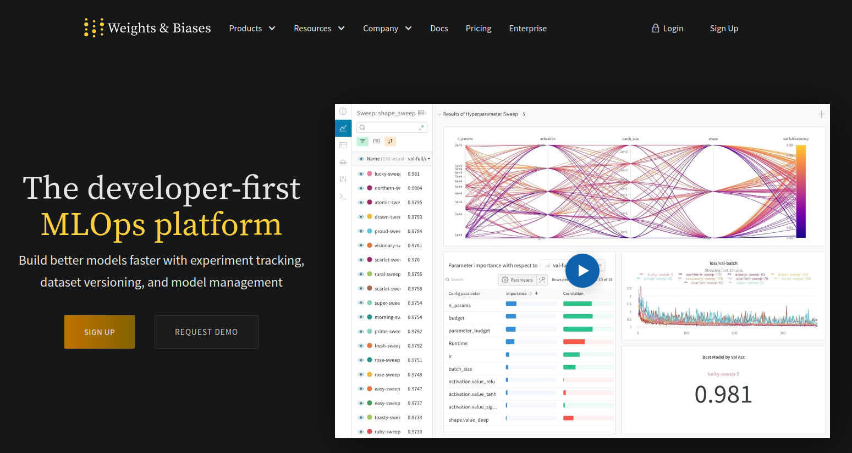
Step 1: Create account with W&B
Navigate to “wandb.ai” on your browser and select “Sign Up”

Slide 15
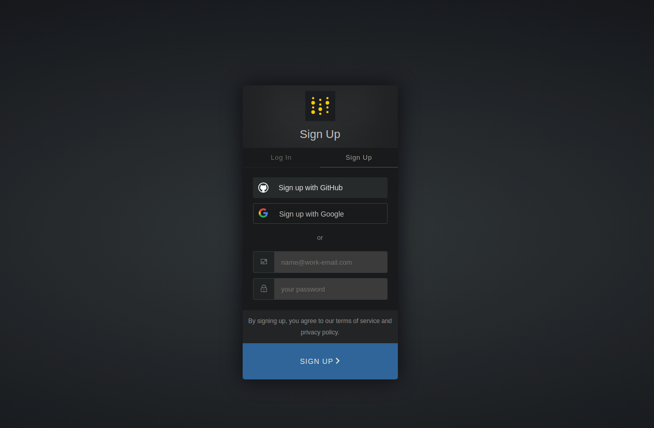
Step 1: Create account with W&B
Follow steps to register

Slide 16
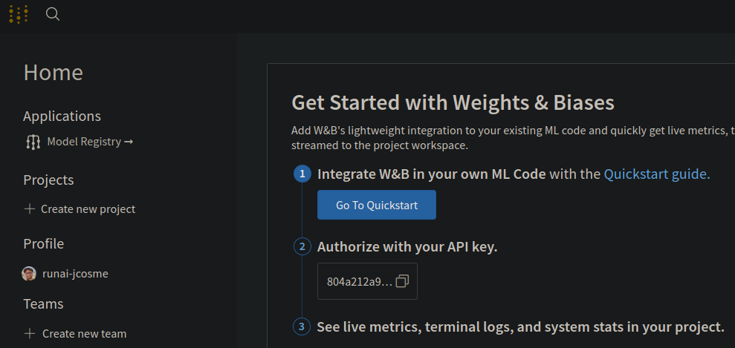
Step 1: Create account with W&B
After registering, click on the W&B icon on the top left. You’ll notice and API key.
This will be used in step 3
1
2

Slide 17
Step 2: Install “wandb” package
We can install wandb with conda.
Here is an example command where we create an environment called “wandb-env” and install the “wandb” package along with Tensorflow
mamba create -n wandb-env -c conda-forge wandb tensorflow tensorflow-gpu -y

Slide 18
Step 3: .netrc file
The .netrc file is created after running “wandb login” command.

Slide 19
Step 3: .netrc file
The .netrc file is created after running “wandb login” command.
The .netrc file is always created in the home directory (~/.netrc)

Slide 20
Step 3: .netrc file
The .netrc file is created after running “wandb login” command.
The .netrc file is always created in the home directory (~/.netrc)
When running wandb within your code, it will always look for the .netrc file in the home directory (~/.netrc)

Slide 21
Step 3: .netrc file
Run the “wandb login” command
wandb login

Slide 22
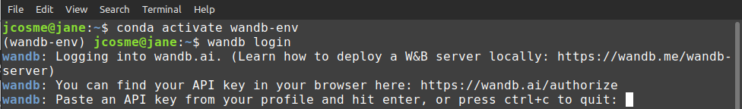
Step 3: .netrc file
Run the “wandb login” command
wandb login
Copy the API key from your W&B account page...
...then paste it into the terminal (and hit enter)

Slide 23
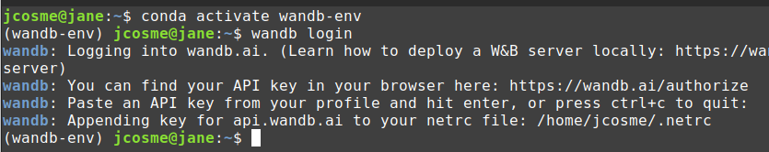
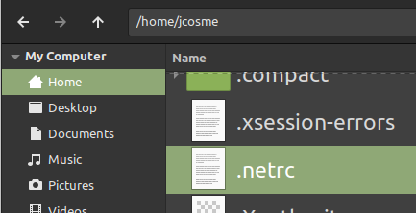
Step 3: .netrc file
A file will be created in your home directory (~/) called “.netrc” (~/.netrc)

Slide 24
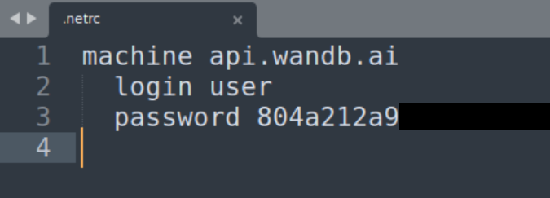
Step 3: .netrc file
A file will be created in your home directory (~/) called “.netrc” (~/.netrc)
The .netrc file is a text file containing your API key

Slide 25
Step 3: .netrc file
A file will be created in your home directory (~/) called “.netrc” (~/.netrc)
The .netrc file is a text file containing your API key
W&B references this file in order to interface with your wandb.ai account.
You will no longer need to run the “wandb login” command.

Slide 26
Step 4: wandb code in your script

Slide 27
Step 4: wandb code in your script
Here are the highlights of the wandb code within our python script
import wandb
from wandb.keras import WandbCallback
from tensorflow import keras
from tensorflow.keras import layers
wandb.init(project="wandb-local")
wandb.config = {
"learning_rate": 0.001,
"epochs": 15,
"batch_size": 128
}
# (load data here)
# (build model)
# (continued on next block)...
# ... (continued from previous block)
opt = keras.optimizers.Adam(
learning_rate=wandb.config['learning_rate']
)
model.compile(
loss="categorical_crossentropy",
optimizer=opt,
metrics=["accuracy"]
)
model.fit(
x_train,
y_train,
validation_split=0.1,
batch_size=wandb.config['batch_size'],
epochs=wandb.config['epochs'],
callbacks=[WandbCallback()],
)

Slide 28
Step 4: wandb code in your script
Here are the highlights of the wandb code within our python script
import wandb
from wandb.keras import WandbCallback
from tensorflow import keras
from tensorflow.keras import layers
wandb.init(project="wandb-local")
wandb.config = {
"learning_rate": 0.001,
"epochs": 15,
"batch_size": 128
}
# (load data here)
# (build model)
# (continued on next block)...
# ... (continued from previous block)
opt = keras.optimizers.Adam(
learning_rate=wandb.config['learning_rate']
)
model.compile(
loss="categorical_crossentropy",
optimizer=opt,
metrics=["accuracy"]
)
model.fit(
x_train,
y_train,
validation_split=0.1,
batch_size=wandb.config['batch_size'],
epochs=wandb.config['epochs'],
callbacks=[WandbCallback()],
)
For more info on how to use wandb code in your scripts, visit docs.wandb.ai

Slide 29
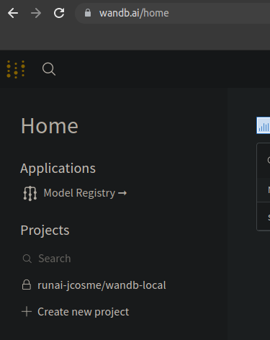
Step 4: wandb code in your script
1
After the script finishes running, refresh your web browser, select the W&B icon on the top left, and you will be able to see the project
2
3

Slide 30
Setting up
W&B with run:ai

Slide 31
What is needed for run:ai to work with W&B?

Slide 32
What is needed for run:ai to work with W&B?
1) An account with W&B
4) wandb code within your python script

Slide 33
What is needed for run:ai to work with W&B?
1) An account with W&B
2) A docker image with wandb installed
4) wandb code within your python script

Slide 34
What is needed for run:ai to work with W&B?
1) An account with W&B
2) A docker image with wandb installed
3) A persistent netrc file
4) wandb code within your python script

Slide 35
Step 2: Docker image with wandb installed

Slide 36
Step 2: Docker image with wandb installed
The docker image we will be using is “jonathancosme/base-root-wandb-tf”*
It is publicly available here:
hub.docker.com/r/jonathancosme/base-root-wandb-tf
*This image uses “jonathancosme/base-notebook-root” as a base image, which is a slight modification of the official “jupyter/base-notebook” image.
More information can be found here: github.com/jonathancosme/jupyter-base-notebook-root

Slide 37
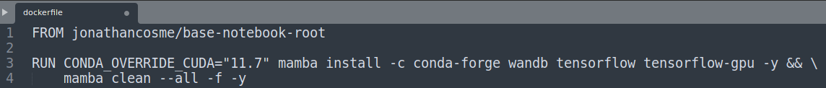
Step 2: Docker image with wandb installed
The docker image we will be using is “jonathancosme/base-root-wandb-tf”*
It is publicly available here:
hub.docker.com/r/jonathancosme/base-root-wandb-tf
This is the dockerfile
This is where we the installation of wandb is speficied
*This image uses “jonathancosme/base-notebook-root” as a base image, which is a slight modification of the official “jupyter/base-notebook” image.
More information can be found here: github.com/jonathancosme/jupyter-base-notebook-root

Slide 38
Step 3: Persistent .netrc file

Slide 39
Step 3: Persistent .netrc file
about wandb login command:

Slide 40
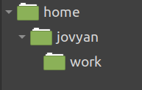
Step 3: Persistent .netrc file
about wandb login command:
The home directory in our image is /home/jovyan
(before we run wandb login)

Slide 41
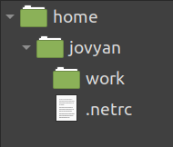
Step 3: Persistent .netrc file
about wandb login command:
The home directory in our image is /home/jovyan
Therefore, the .netrc file will be created as /home/jovyan/.netrc
(before we run wandb login)
(after we run wandb login)

Slide 42
Step 3: Persistent .netrc file
about wandb login command:
The home directory in our image is /home/jovyan
Therefore, the .netrc file will be created as /home/jovyan/.netrc
(before we run wandb login)
(after we run wandb login)
wandb will always look for that file in that location

Slide 43
Step 3: Persistent .netrc file
we want to create a persistent copy of the netrc file on our NFS...
persistent storage (NFS)
wandb_creds
netrc

Slide 44
Step 3: Persistent .netrc file
we want to create a persistent copy of the netrc file on our NFS...
...so that we can mount that file in our image, when we run jobs
persistent storage (NFS)
image
wandb_creds
wandb
netrc
.netrc

Slide 45
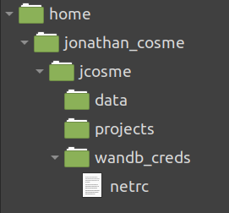
Step 3: Persistent .netrc file
we want to create a persistent copy of the netrc file on our NFS...
...so that we can mount that file in our image, when we run jobs
persistent storage (NFS)
image
wandb_creds
wandb
netrc
.netrc

Slide 46
Step 3: Persistent .netrc file
we want to create a persistent copy of the netrc file on our NFS...
...so that we can mount that file in our image, when we run jobs
persistent storage (NFS)
image
wandb_creds
wandb
netrc
.netrc

Slide 47
Step 3: Persistent .netrc file
how do we create a persistent netrc file?

Slide 48
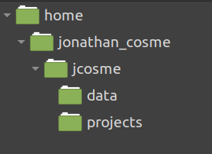
Step 3: Persistent .netrc file
how do we create a persistent netrc file?
1. mount our NFS
(NFS)

Slide 49
Step 3: Persistent .netrc file
how do we create a persistent netrc file?
1. mount our NFS to the jupyter work directory
(NFS)
(jupyter)

Slide 50
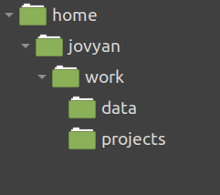
Step 3: Persistent .netrc file
how do we create a persistent netrc file?
1. mount our NFS to the jupyter work directory
(NFS)
(jupyter)

Slide 51
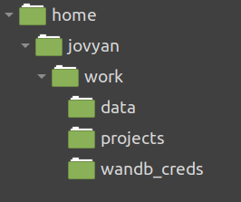
Step 3: Persistent .netrc file
how do we create a persistent netrc file?
2. Create the wandb_creds folder in the mounted directory

Slide 52
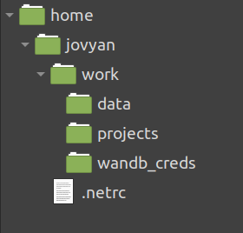
Step 3: Persistent .netrc file
how do we create a persistent netrc file?
3. Create the .netrc file (with wandb login command)

Slide 53
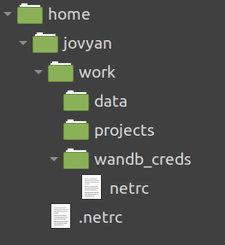
Step 3: Persistent .netrc file
how do we create a persistent netrc file?
3. Copy .netrc file to created wandb_creds folder

Slide 54
Step 3: Persistent .netrc file
(Live demo)

Slide 55
Running
W&B with run:ai

Slide 56
Running wandb jobs with run:ai

Slide 57
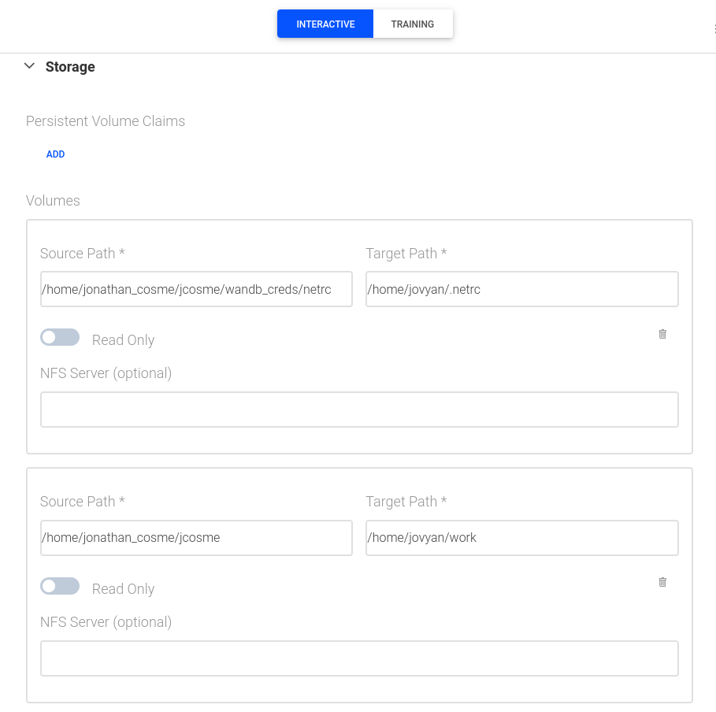
Running wandb jobs with run:ai

Slide 58
Running wandb jobs with run:ai
From now on, it is VERY important that we mount the persistent netrc file in our NFS, to the expected location of the netrc file in our image
in our case, the persistent netrc file is at:
/home/jonathan_cosme/jcosme/wandb_creds/netrc
and it should be mounted to:
/home/jovyan/.netrc
persistent netrc file in our NFS
expected location of netrc file in our image

Slide 59
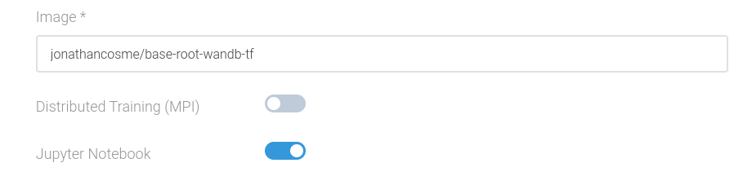
Running wandb jobs with run:ai
From now on, it is VERY important that we mount the persistent netrc file in our NFS, to the expected location of the netrc file in our image
in our case, the persistent netrc file is at:
/home/jonathan_cosme/jcosme/wandb_creds/netrc
and it should be mounted to:
/home/jovyan/.netrc
persistent netrc file in our NFS
expected location of netrc file in our image
Use the jonathancosme/base-root-wandb-tf image, and mount our NFS directory to the work directory as usual
normal NFS mount

Slide 60
Jupyter notebook example
(Live demo)

Slide 61
CLI example
(Live demo)

Slide 62
CLI example
we can run wandb_demo.py via the CLI with this command

Slide 63
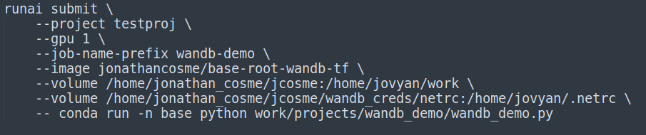
CLI example
we can run wandb_demo.py via the CLI with this command

Slide 64
CLI example
we can run wandb_demo.py via the CLI with this command
here are the key highlights

Slide 65
CLI example
we can run wandb_demo.py via the CLI with this command
here are the key highlights
use image with wandb installed

Slide 66
CLI example
we can run wandb_demo.py via the CLI with this command
here are the key highlights
use image with wandb installed
mount NFS to work directory

Slide 67
CLI example
we can run wandb_demo.py via the CLI with this command
here are the key highlights
use image with wandb installed
mount NFS to work directory
mount netrc file

Slide 68
CLI example
we can run wandb_demo.py via the CLI with this command
here are the key highlights
use image with wandb installed
mount NFS to work directory
mount netrc file
command to run wandb_demo.py script

Slide 69
CLI example
(Live demo)

Slide 70
Thank you!
contact@wandb.ai
|
www.wandb.ai

